Slide 1
Machine Learning demystified: do you ask the right questions?
Bianca Furtuna
Technical Evangelist
@Fur_Bi

Slide 2


Slide 3
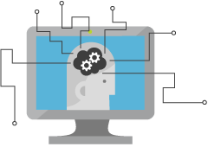
What is Machine Learning?
Computing Systems that become smarter with Experience
Experience = Past Data + Human Input
@Fur_Bi

Slide 4
Learning?
Y = aX - b
y = 4.8081x - 56.241
@Fur_Bi

Slide 5
How can Machine Learning bring value?
Machine
Learning
Data
Insights
@Fur_Bi

Slide 6
Questions?
Use maths to answer questions
@Fur_Bi

Slide 7
What type of questions?
Is this class A or class B?
Is this class A or class B or class C or …. class Z?
How much/How many?
Is this anomalous behaviour?
What are the patterns/groupings?
@Fur_Bi

Slide 8
Is this class A or class B?
Is there a face in this image or not?
Will this patient get lung cancer?
Will this machine fail in the next month?
= Two-class/Binary classification
@Fur_Bi

Slide 9
Is this class A or class B or class C or …. class Z?
What object is in this image?
What category best describes this article?
What is the sentiment of the customer comment?
= Multi-class classification
@Fur_Bi

Slide 10
How much/How many?
How much ice-cream will be sold?
How much is the price of this house?
How many hours of use are left for this piece of equipment?
= Regression
@Fur_Bi

Slide 11
Is this anomalous behaviour?
Is this sensor reading out of the normal range?
Is the internet usage unusual?
Is this online transaction unusual?
= Anomaly Detection
@Fur_Bi

Slide 12
What are the patterns/groupings?
Which of my customers have similar spending habits?
How can these news articles be grouped?
Which users have similar movie preferences?
= Clustering
@Fur_Bi

Slide 13
Machine Learning Myths
Machine Learning needs a lot of data
The more features the better
Machine Learning can get insights from any data
Machine Learning replaces human analysts
Machine Learning is all about the model you choose
@Fur_Bi

Slide 14
Machine Learning Process
Idea
Business Knowledge
Data Understanding
Data
Data Preparation
Modelling
Evaluation
Publish
Based on the CRISP-DM Model

Slide 15
Machine Learning Process
Use case
Data
Prep + Build + Test
Publish
Data Preparation
Evaluation
Modelling

Slide 16
Data
Clients
API
ML STUDIO
Model is now a web service that is callable
Blobs and Tables
Hadoop (HDInsight)
Relational DB (Azure SQL DB)
Integrated development environment for Machine Learning
Monetize the API through our marketplace
Notes:
The elegance of the solution is in its simplicity – something that has been lacking in the machine learning space
The first issue many enterprises face is data ingestion. With the cloud, you can bring in data sources with the ease of a drop down or drop your on-premises data set into the built in storage space. Users can then model in our development environment – Machine Learning Studio
where we’re offering R, Python and SQLite as first class citizens in addition to our world-class Microsoft algorithms.
The second issue – and often the primary one – is putting finished work into production in a way others can use. Client devices, websites, mobile applications, excel spreadsheets you name it anything that supports HTTP requests.
We’ve heard from many data scientists that they model in R on a Linux stack but then have to hand over their work to developers who need to translate that into another language to actually make it work.
This time consuming and unnecessary process has been eliminated with our system, as the model is with a click transformed into a web service end-point that can run over any data, anywhere and connect to any solution or client.
Next, not only can this model be put into production for your company, it can be made available for the world on our Machine Learning Marketplace. Microsoft hosts your solution and markets it for you, while you have the freedom to brand and monetize as you see fit.

Slide 17
Demo
@Fur_Bi

Slide 18
Machine Learning Process
Use case
Data
Prep + Build + Test
Publish
Data Preparation
Evaluation
Modelling

Slide 19
Use Case/Scenario
AuthenticGiftsX is a company that is offering hand-made, personalised gifts which are dispatched in custom-made boxes. Their delivery labels are hand-written to give their customers a sense of authenticity. In order to improve and automate their delivery system they want a mobile app which can recognize the delivery address based on a picture of the label.
@Fur_Bi

Slide 20
Machine Learning Process
Use case
Data
Prep + Build + Test
Publish
Data Preparation
Evaluation
Modelling

Slide 21
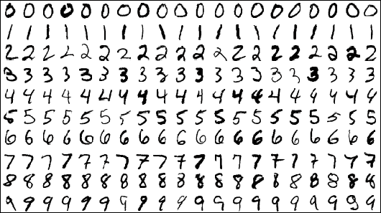
Data
MNIST dataset which consists of 70,000 grayscale images of hand-written digits
28x28 pixels
@Fur_Bi

Slide 22
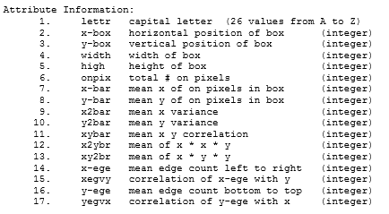
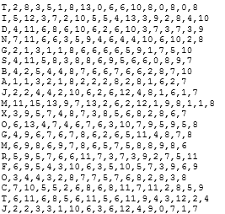
Data
Letter recognition data from UCI Machine Learning repository
20000 unique images
@Fur_Bi

Slide 23
Machine Learning Process
Use case
Data
Prep + Build + Test
Publish
Data Preparation
Evaluation
Modelling

Slide 24
What is a neural network?
@Fur_Bi

Slide 25
Machine Learning Process
Use case
Data
Prep + Build + Test
Publish
Data Preparation
Evaluation
Modelling

Slide 26
Action !!!
Go to Azure Machine Learning Studio and create your first experiment.
@Fur_Bi

Slide 27

Thank you!
@Fur_Bi
bifurt@microsoft.com
http://furbi.azurewebsites.net/

